Slide 1
What’s new in mobile world
March - 2020

Slide 2
What is new - Agenda
Where are we?
What might be next?
Statistics that matter
Q&A

Slide 3
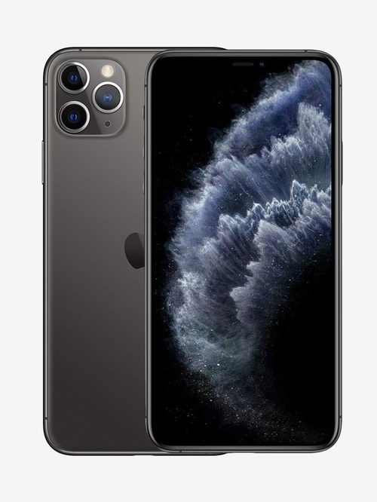
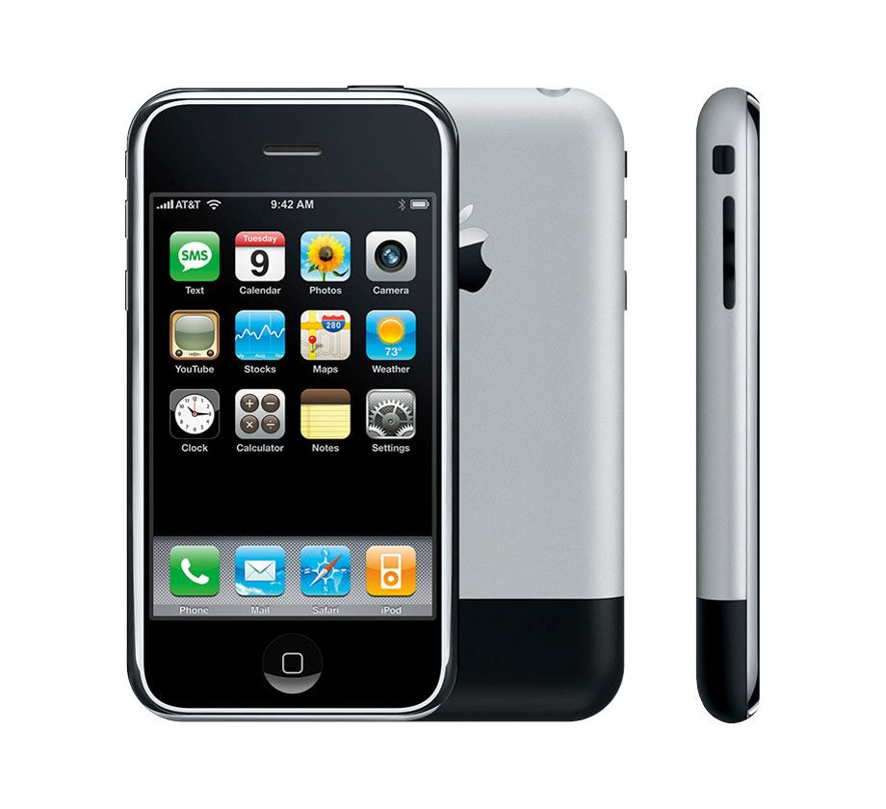
The transition
2007 - iPhone 1
2019 - iPhone 11 Pro

Slide 4
Enhanced CPU and RAM
iPhone 1 (2007) | iPhone 11 Pro (2019)
Samsung 32-bit RISC ARM 1176JZ(F)-S v1.0 620 MHz Underclocked to 412 MHz | Hexa-core (2× high power Lightning cores at 2.66 GHz + 4× low power Thunder cores at 1.82 GHz)
128 MB eDRAM | 4 GB - 4096 MB LPDDR4X RAM (32 times) 32 times
Source: Wikipedia
Notes:
underclocked to save battery
dedicated CPU for mobiles

Slide 5


Enhanced CPU and RAM
Faster processing of tasks.
Multiple cores for CPU and dedicated GPU on device.
A game changer in entertainment apps, games, security etc.
Simulating physics engine
Notes:
run at 60fps

Slide 6
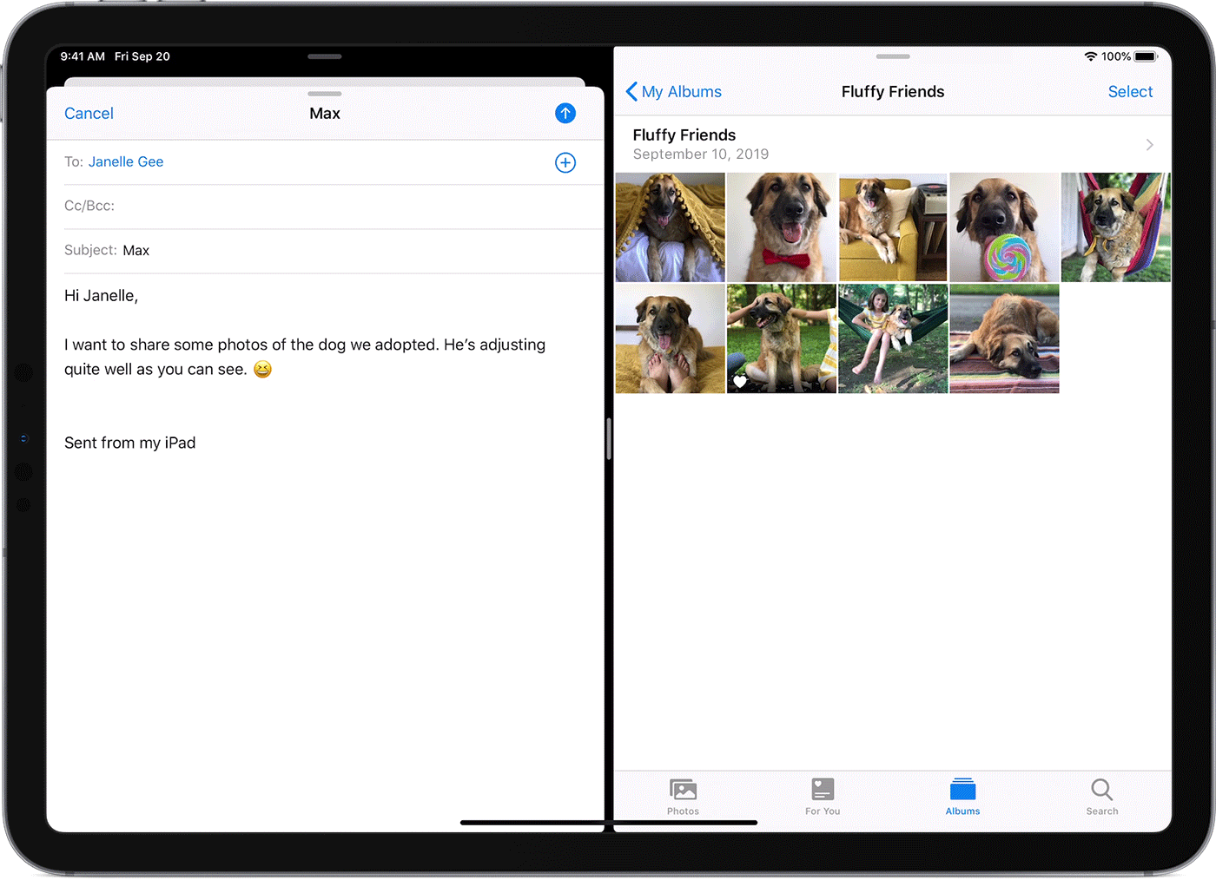
Enhanced CPU and RAM
Higher memory on device allows OS to concurrently run multiple apps.
Helps in allowing user to
scroll through Twitter while
chatting on Whatsapp. Or
watching a video on Youtube with picture in picture
Notes:
games like pubg
image/video editing

Slide 7
Internet speed
2G GPRS - 40 kbit/s
EDGE - 384 kbit/sec
4G LTE - 300 Mbit/s - 300000 kbit/s
7500x increase
Had a direct impact on every aspect of life today.
From consumer apps to businesses, we have a visible change in the landscape.
As a live example, In the pretext of Covid-19, a lot of organizations could allow users to work remotely.
Notes:
EDGE (Enhanced Data Rates for GSM Evolution)
LTE Advanced (Long Term Evolution Advanced)
Youtube, Tiktok, Instagram, PubG, Pokemon Go
There is hardly any app that doesn’t require network

Slide 8
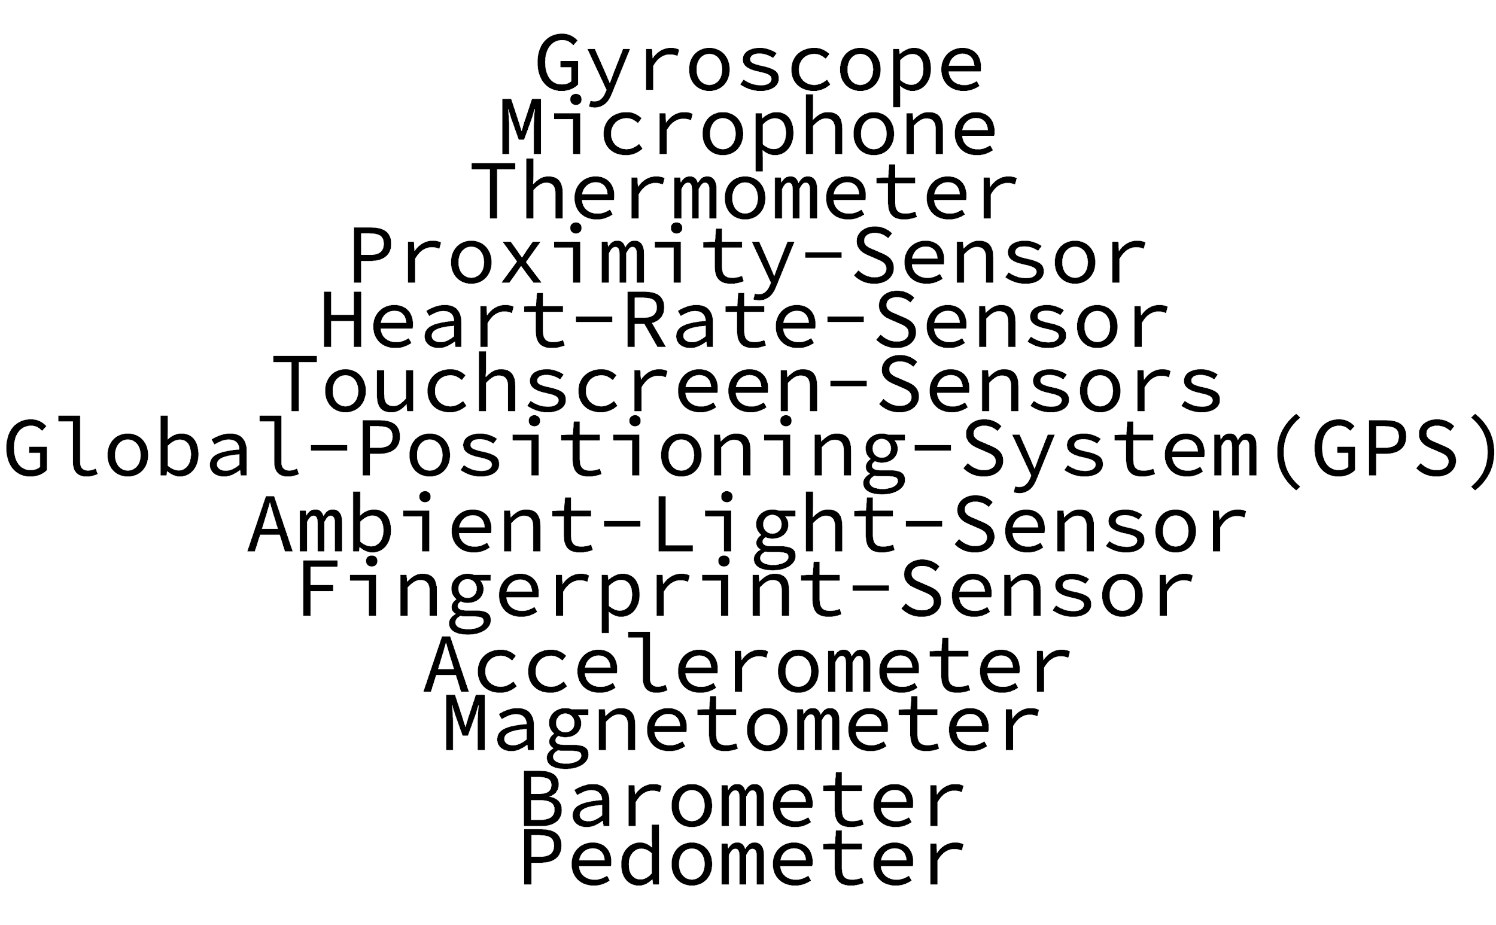
Better sensors
Impacts:
Physical activity tracking
Medical state monitoring
Infrared sensors help in face detection in darkness
Notes:
accuracy
GPS - Zendrive Fingerprint for security

Slide 9
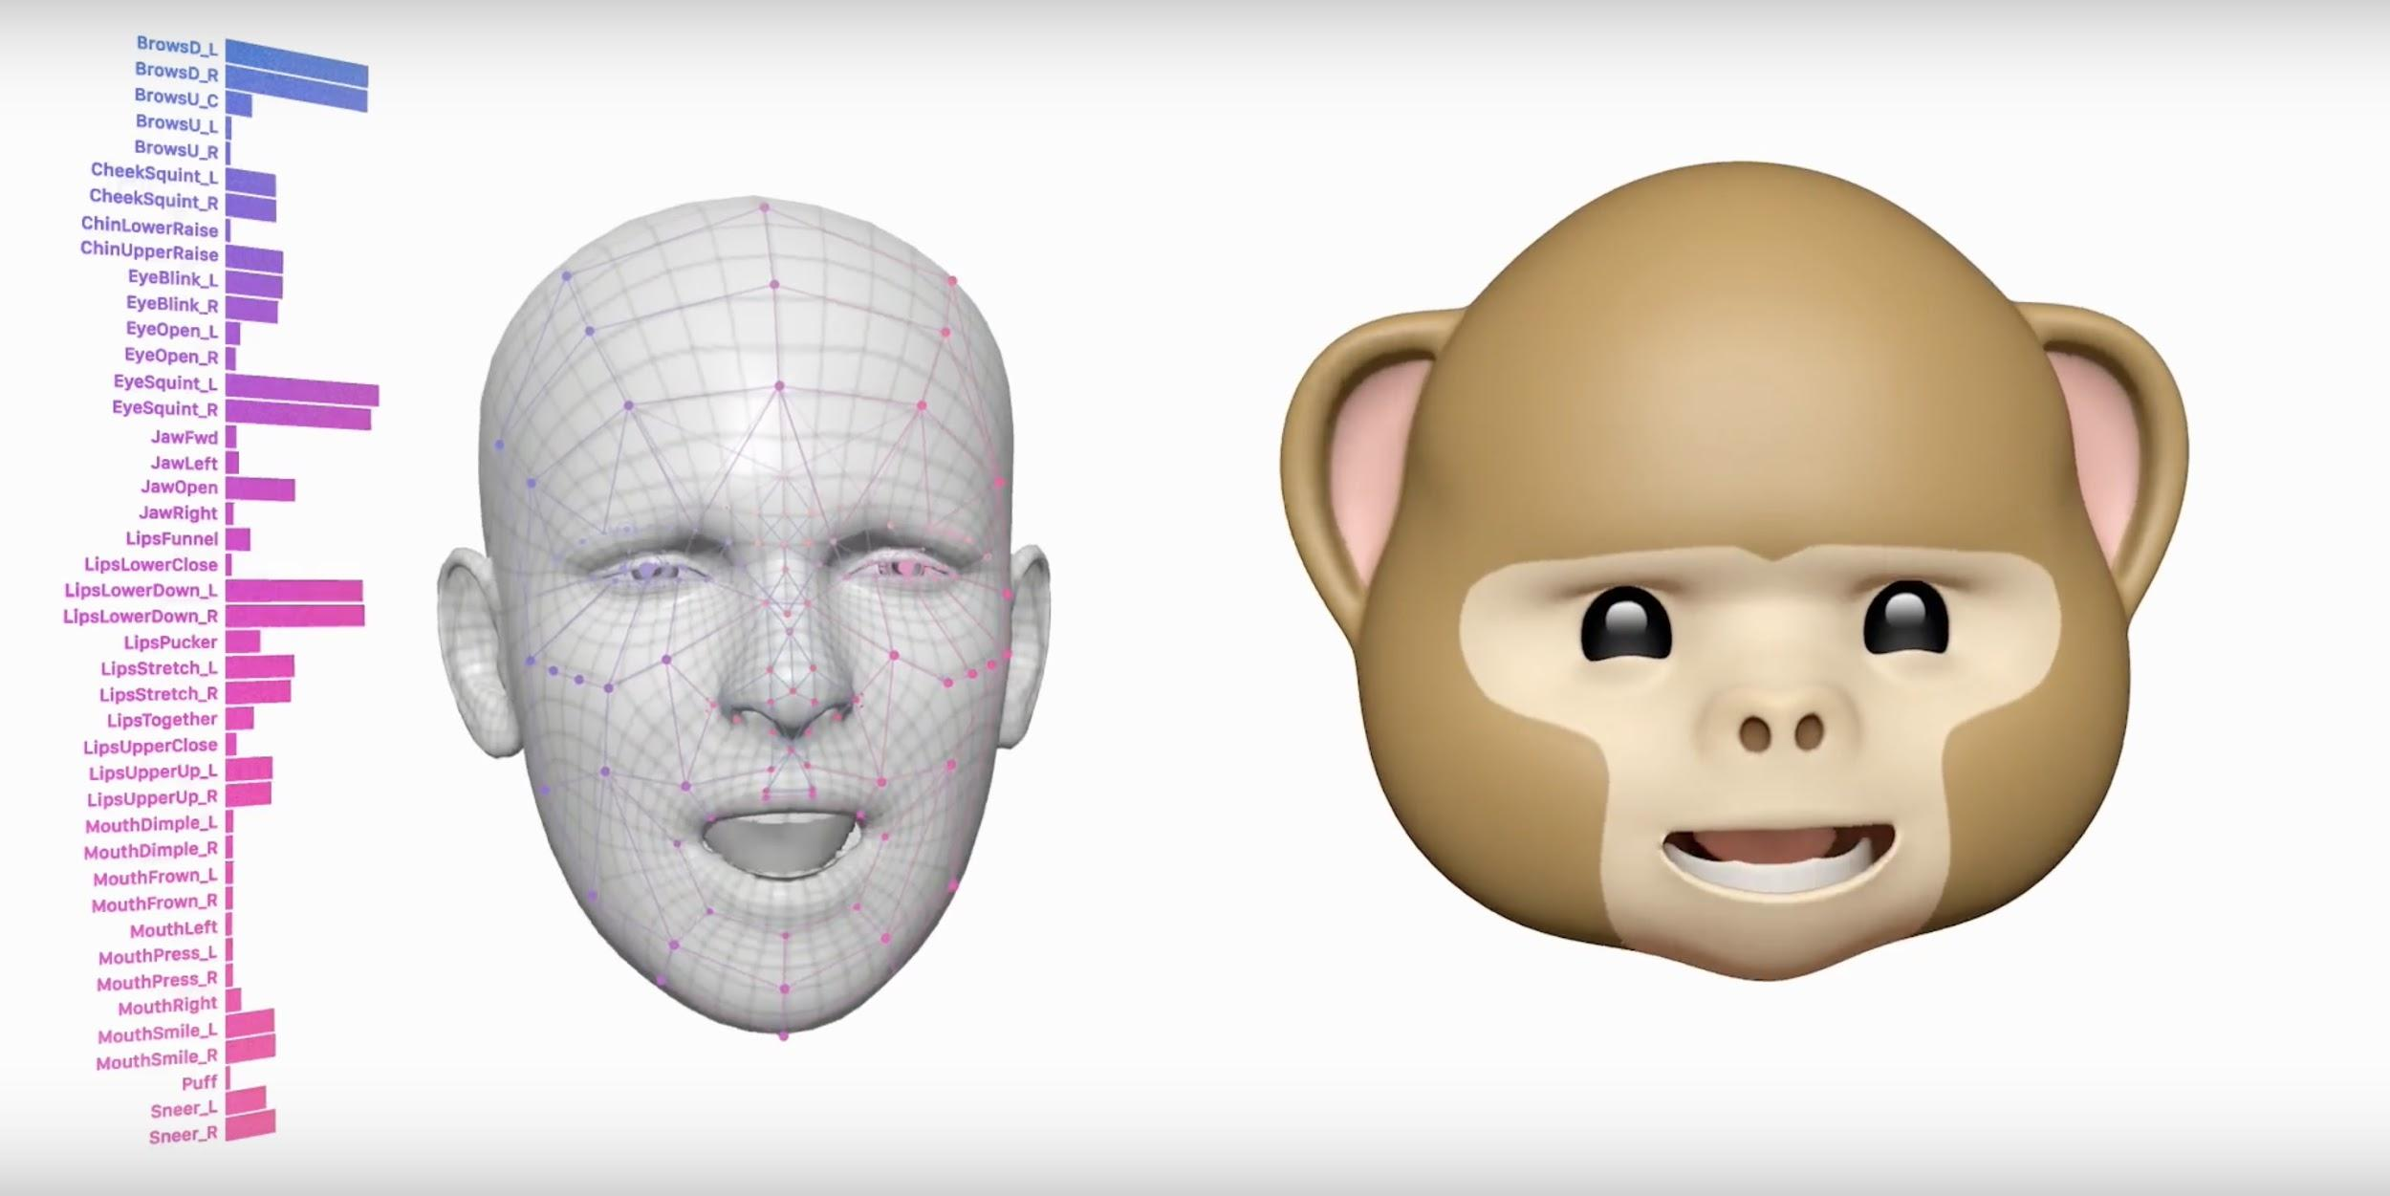

Machine Learning on device
Face and fingerprint lock
Biometric ID
Detect and work with facial augmentations like hat, beard, glasses etc
Animoji/Memoji
Notes:
For face detection
infrared to work in dark

Slide 10
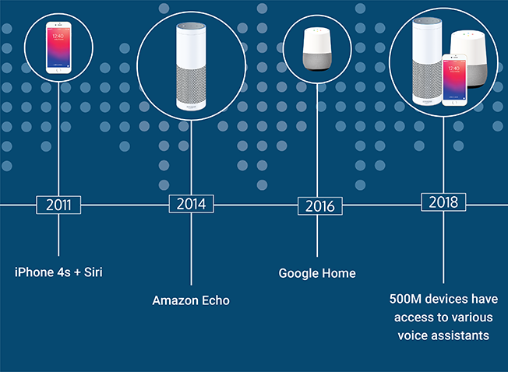
Machine Learning on device
Siri/Google Assistant/Alexa - Voice assistant
Detects the invoking phrase “Hey siri”, “Alexa”, “Ok google” on device
Notes:
assistant - instead of streaming the whole audio stream to servers -
instantaneous.
privacy

Slide 11
Camera enhancements
iPhone 1 | iPhone 11
2MP rear camera | 12 MP both rear and front. Rear - triple-lens with optical zoom one ƒ/2.4 aperture ultra wide angle lens one ƒ/1.8 wide angle lens one ƒ/2.0 telephoto lens optical image stabilization (on wide-angle and telephoto, not on ultrawide), brighter dual-LED flash, autofocus, IR filter, Burst mode, 6-element lens, 4K video recording at 24, 30 or 60 FPS or 1080p at 30 or 60 FPS, slow-motion video (1080p at 120 FPS or 240 FPS), time-lapse with stabilization, panorama (up to 63 megapixels), portrait mode, portrait lighting, facial recognition, digital image stabilization, stereo audio recording
Notes:
memories

Slide 12

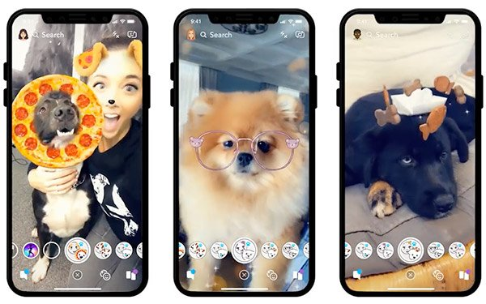
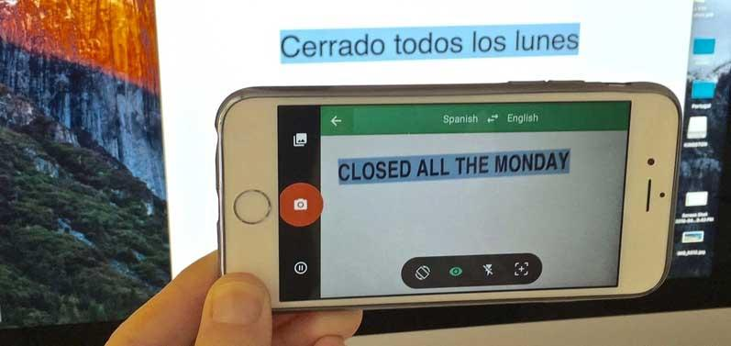
Augmented Reality / Virtual Reality
Impact:
Gaming - well known Pokemon Go
Google translate
Shopping Experience - Lenskart
Entertainment - Snapchat/Instagram video filters
Screen resolution helps in giving a near real experience
Notes:
Though in nascent stages, display of 120 Hz will help this + games

Slide 13
Security & Privacy
Secured Enclave - iOS
Permissioning model
End to end encryption - Whatsapp, Signal
Notes:
secure enclave - processor - microkernel - keeps decryption keys

Slide 14
Next
Wearable Tech
Google glasses
Smart Watches + Activity Trackers
Apple Watch / Android watches
Internet of Things
Smart homes
Your run of the mill products become intelligent in their own way

Slide 15
Statistics

Slide 16
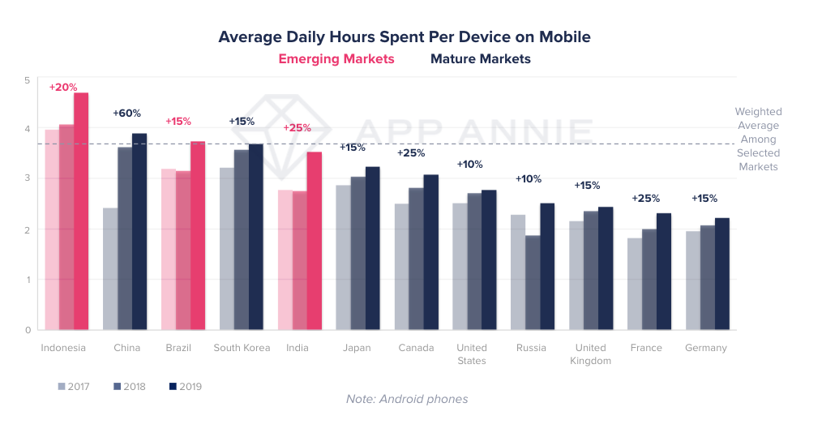
State of mobile - statistics that matter
Notes:
appannie/statistica
chinese manufacturers
jio

Slide 17
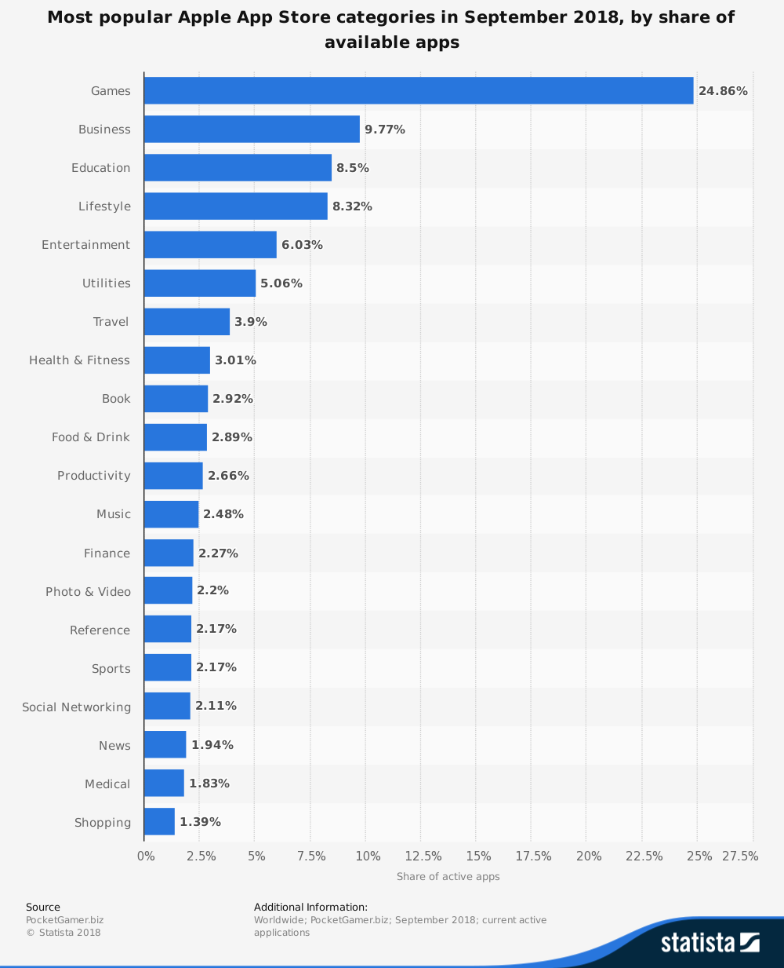
State of mobile - statistics that matter

Slide 18
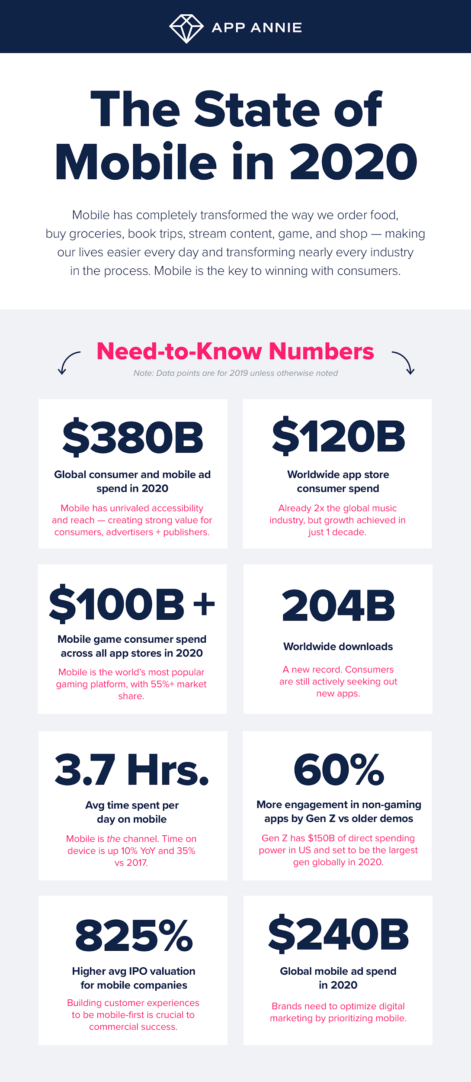
State of mobile - statistics that matter

Slide 19
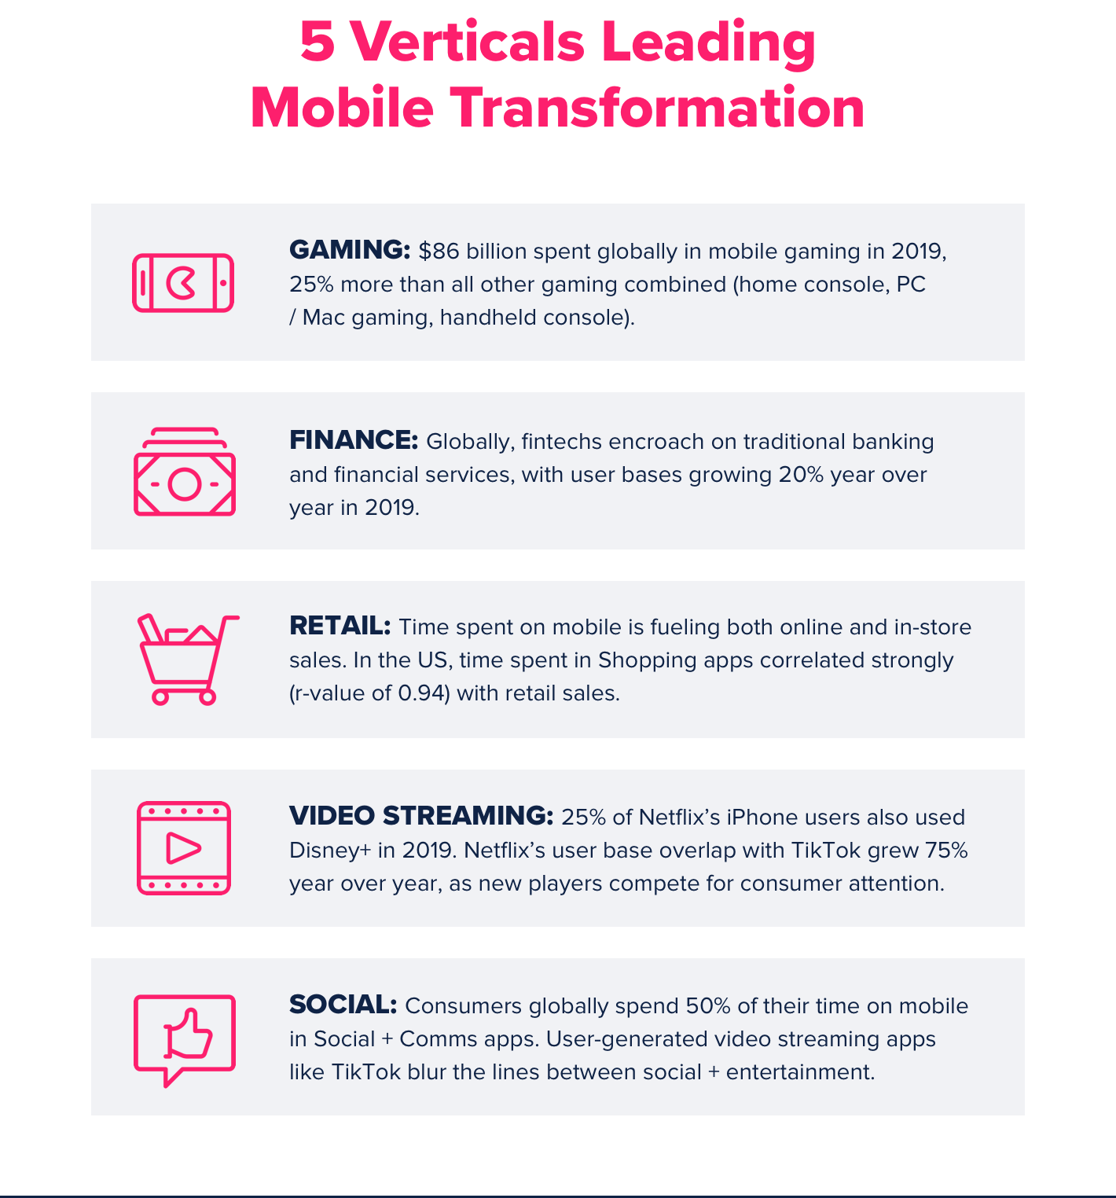
State of mobile - statistics that matter

Slide 20
Q&A
Notes:
Repeat Questions

Slide 21
Thanks
ayushg@zendrive.com

